Slide 1

2012 Fall Faculty Conference

Slide 2
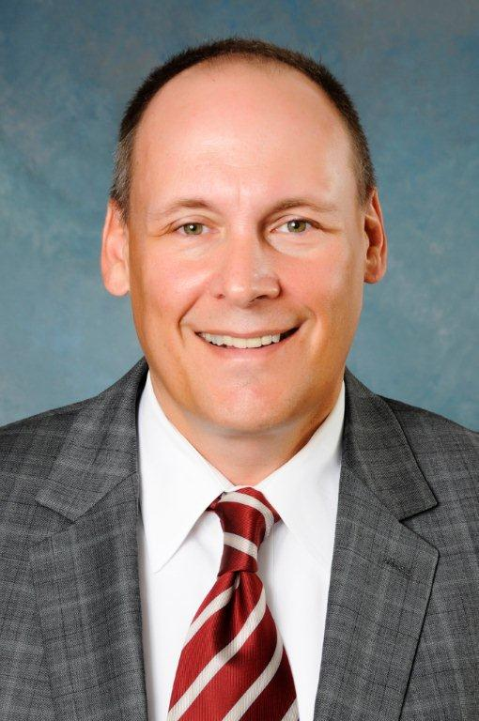

Who’s New at ASU…
Dr. Brad Rawlins
Dean
College of Communications

Slide 3
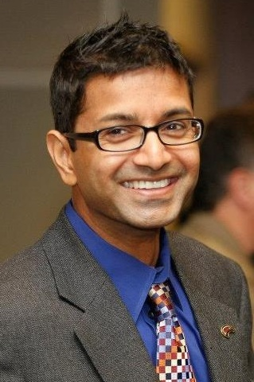
Who’s New at ASU…
Dr. Thilla Sivakumaran
Dean
College of
Education

Slide 4
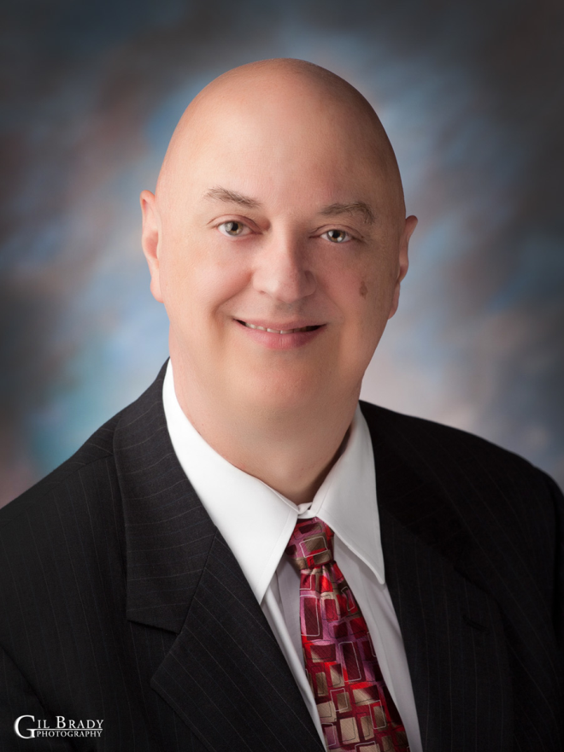
Who’s New at ASU…
Dr. Don Bowyer
Dean
College of
Fine Arts

Slide 5
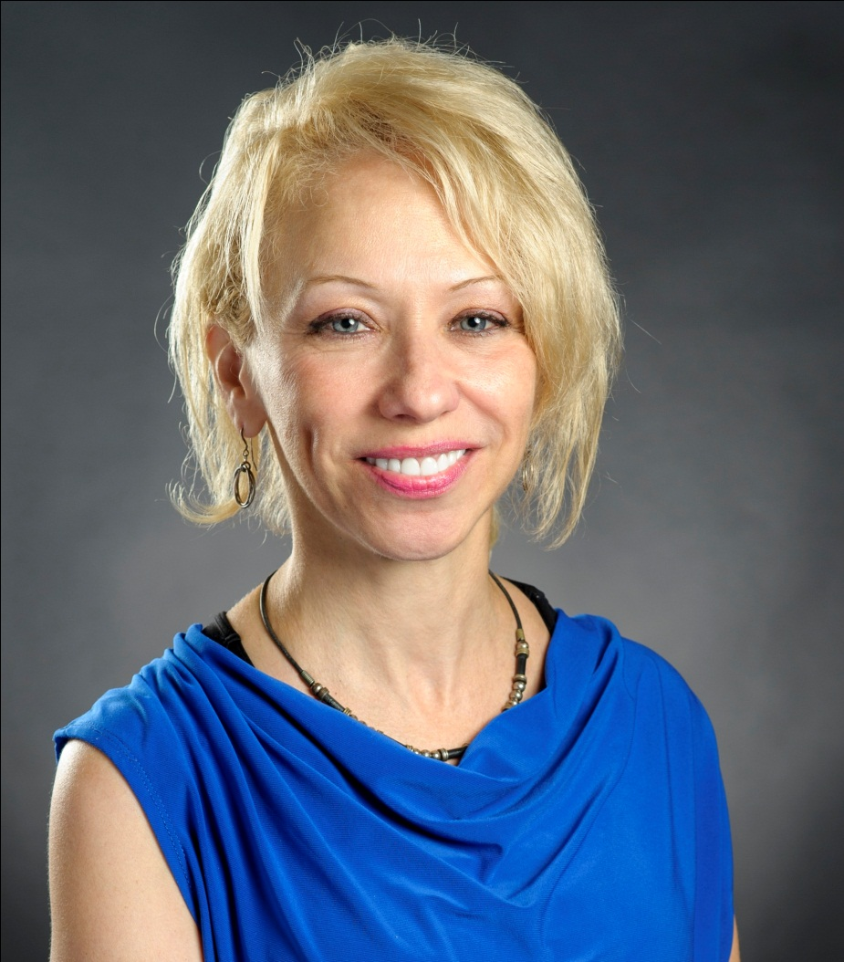
Who’s New at ASU…
Dr. Lauri Umansky
Dean
College of
Humanities &
Social Sciences

Slide 6
Reassignments in Academic Affairs & Research…
Dr. Lynita Cooksey
Interim Provost and Vice Chancellor

Slide 7
Reassignments in Academic Affairs & Research…
Dr. Andy Sustich
Interim Associate Vice Chancellor for Research and Technology Transfer
Interim Director of the Arkansas Biosciences Institute
Dean of the Graduate School

Slide 8
Reassignments in Academic Affairs & Research…
Dr. Gina Hogue
Interim Associate Vice Chancellor
for Academic Services

Slide 9
Reassignment in Agriculture &Technology…
Dr. Bud Kennedy
Interim Dean
College of Agriculture & Technology

Slide 10
Reassignment in Business…
Dr. Jim Washam
Interim Dean
College of Business

Slide 11
Reassignments in Humanities & Social Sciences…
Dr. Pam Hronek
Interim Chair
Department of History
Dr. Larry Salinger
Interim Chair
Department of Criminology, Sociology & Geography

Slide 12
Reassignments in University College…
Dr. Jill Simons
Executive Director of University College
(Dr. Simons has assumed full responsibility for University College)
Melissa Jackson
Director
Wilson Advising Center
Vallary Bingham
Coordinator
Learning Support Services

Slide 13
Reassignment in Sciences &Mathematics…
Dr. John Pratte
Interim Dean
College of Sciences and Mathematics

Slide 14
Reassignment in the Library…
Jeff Bailey
Director
Dean B. Ellis Library

Slide 15
Changes in the Honors College…
Rebecca Oliver
Director
Honors College
(Rebecca has assumed full responsibility for the Honors College)

Slide 16

Higher Learning Commission Self-Study Update …
Fall 2013 Comprehensive Visit
Criterion Committee data being aligned with new HLC criteria
Self-study draft in preparation
Committees will begin review of self-study draft this fall

Slide 17
Assessment Update…
Fall Syllabi Submission
lab
General Education Syllabi
List the primary general education goal and associated student learning outcomes linked to the gen ed course
Major Field Syllabi
List the primary program goal and associated student learning outcomes linked to the major field course

Slide 18
Change in Syllabi Submission Process
Each college now collects and reviews syllabi. Department chairs can provide instructions regarding submission. You do not submit to the HLC repository this fall.
Remember that a separate syllabus is required for each course and section! Label each file by the five-digit CRN…include ONLY the five digits in the label: 62403.docx or 62403.pdf

Slide 19
See the assessment website for additional information such as General Education Learning Outcomes and other assessment specifics
To find the Assessment Website…
Go to A-Z index Assessment Updates What’s Due?
Contact Dr. Josie Welsh
jwelsh@astate.edu 972-2989

Slide 20
Change in Undergraduate Admissions
Undergraduate Admissions has moved to the Office of the Registrar, which has been renamed as the Office of Admissions, Records and Registration.
Student recruitment initiatives will be provided by the Office of Recruitment in Student Affairs.

Slide 21

First Year Convocation…
Don’t forget
First Year Convocation
Sunday, August 19
Faculty line up at 1:30 pm in Hames Room, Convocation Center
(use Red Box Office entrance)
Please wear your academic regalia

Slide 22
WN Grading Reminder…
Failure to participate in WN grading may require ASU to pay back inappropriately awarded financial aid for students who never attended and were not reported as such with a WN
Please monitor attendance from August 20-September 4 and report non-attenders during the WN grading period

Slide 23
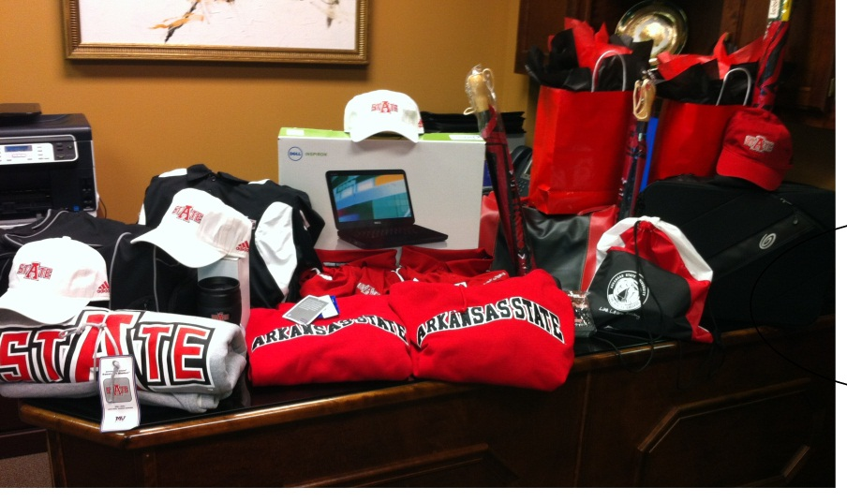
Today’s Door Prizes…
Sign up at table outside Centennial Hall
Door Prizes will be awarded during lunch
Must be present to win!
Some of the prizes to be given away…
Dell Inspiron Laptop
Two, $1000 Professional Development Awards (may be used for travel, workshop, etc.)
Two, Course Reassignment Awards
Tee Shirts, Tote Bags, Umbrellas and more!

Slide 24
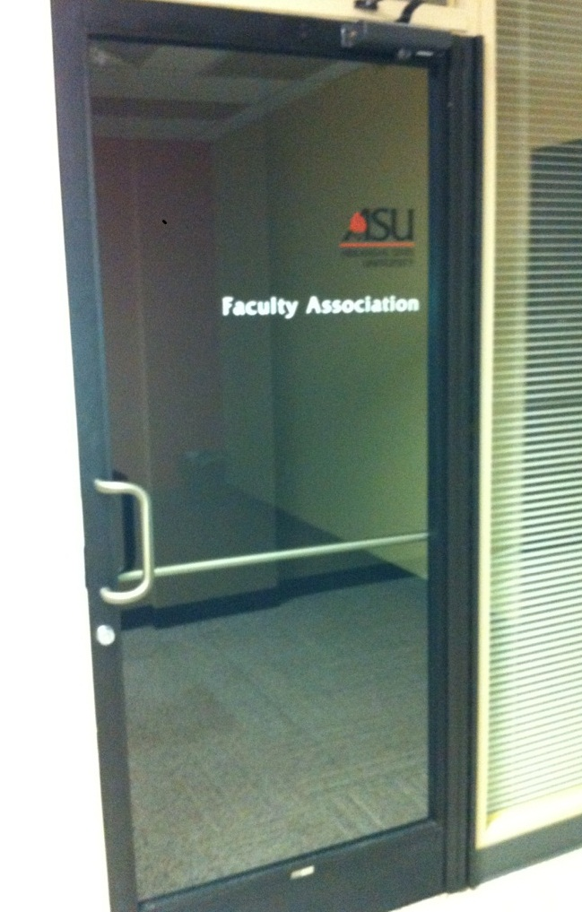
New Faculty Association Office…
Located on the first floor of the Administration Building across from Creative Services

Slide 25
Arkansas State University educates leaders, enhances intellectual growth and enriches lives.

