Slide 1

Comparing Water Quality in Channelized and Natural Streams
Jennifer L. Bouldin, PhD Dept. of Biological Sciences
M. Katie Kilmer Environmental Science PhD Student
Nicole Poe Dept. of Biological Sciences Undergraduate

Slide 2
Experiential Learning Fellowship (ELF) Program
PI: Travis Marsico, Hashim Ali, Jennifer Bouldin, Tanja McKay
NSF funded - $567,185
Scholarships in STEM
2011-2016
Scholarship for undergraduate researchers
Graduate student mentor
Travel to meetings

Slide 3
Experiential Learning Fellowship (ELF) Program
Currently – 8 undergraduates; 4 graduate mentors
8 students graduated
U of OK
Kansas State
UAMS
A-State
Nursing school
Military

Slide 4
Experiential Learning Fellowship (ELF) Program
20+ presentations
Local, state, national and international conferences
Nicole Poe
Poster Presentations
Society of Environmental Toxicology and Chemistry (Fall 2013)
Arkansas Soil and Water Education Conference (Jan 2014)
Oral Presentations
Create@StAte (April 2014)
Arkansas Waterworks & Water Environment Association (April 2014)

Slide 5
SMART Center
Science & Mathematics Academic Resources and Tracking Center
Coordinate research & education projects
Advising
Student data – tracking progress
Prepare for post-graduation careers

Slide 6
SMART Center
Science & Mathematics Academic Resources and Tracking Center
Professional development
Test prep, interviewing and development training
Provide post graduation tracking
HLC, NSF, NIH, etc.
Decrease faculty time and redundancy of development workshops.

Slide 7
Comparing Water Quality in Channelized and Natural Streams
Jennifer L. Bouldin, PhD Dept. of Biological Sciences
M. Katie Kilmer Environmental Science PhD Student
Nicole Poe Dept. of Biological Sciences Undergraduate

Slide 8
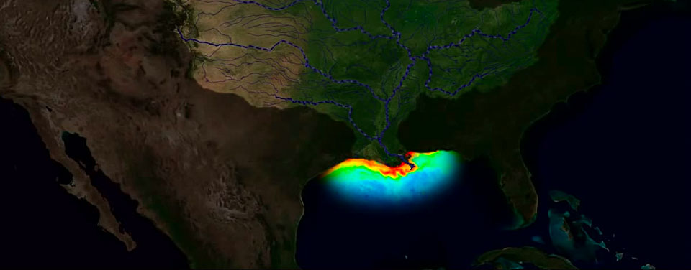
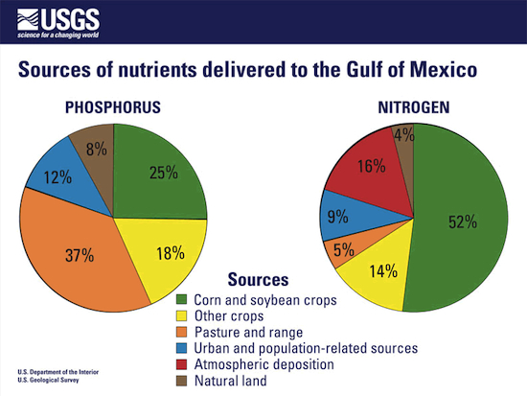
‘Dead Zone’ in Gulf of Mexico
http://oceanservice.noaa.gov/news/june14/hypoxia.jpg
5,052 square miles (2014)
Nutrient pollution
Urban/agricultural contributions

Slide 9
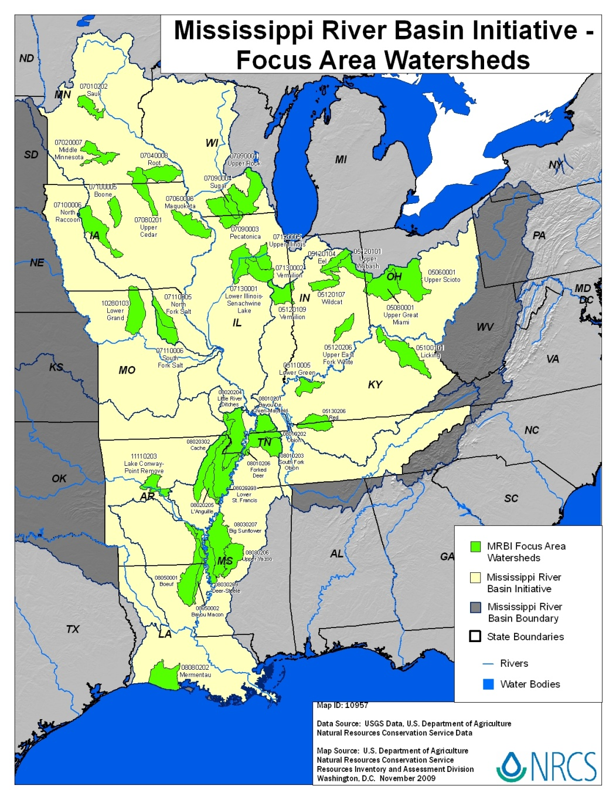
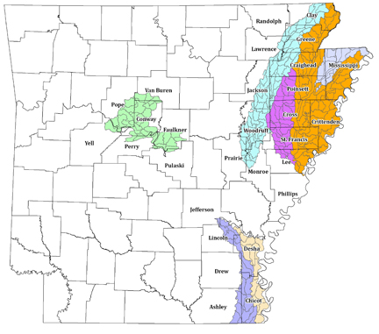
http://www.nj.nrcs.usda.gov/Internet/FSE_MEDIA/nrcs142p2_033735.jpg

Slide 10
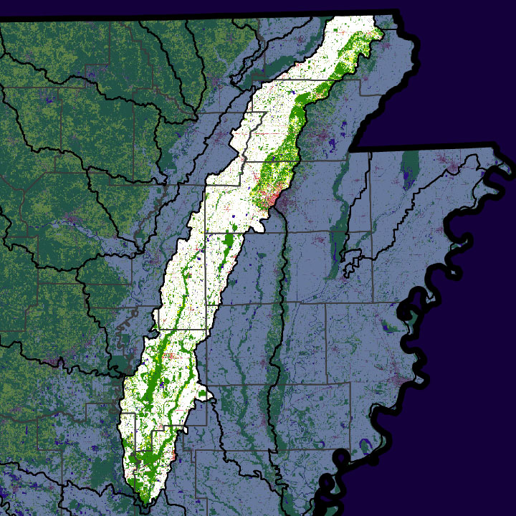
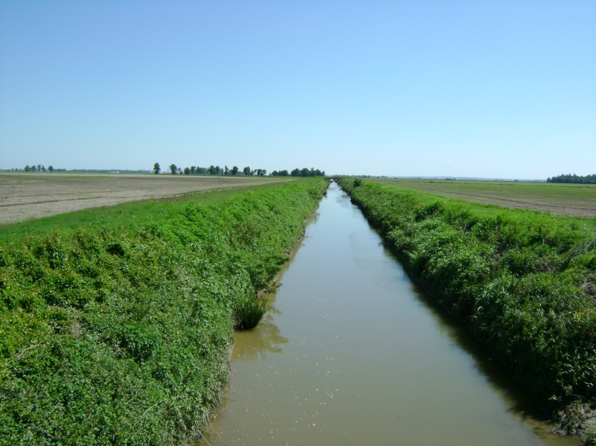
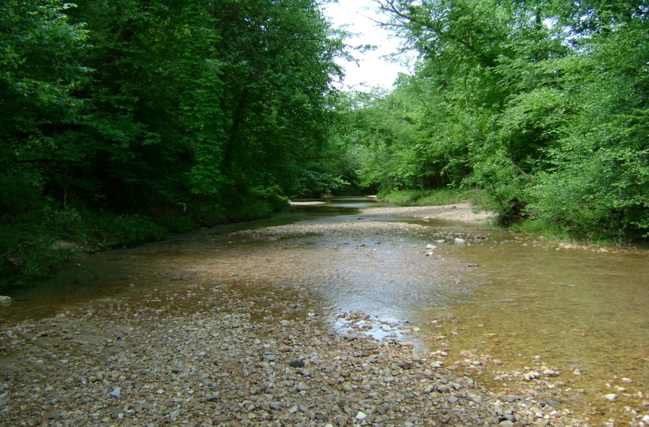
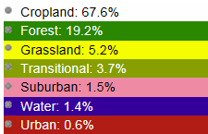
Cache River, Arkansas
arkansaswater.org
Photo credit: Katie Kilmer
Photo credit: Katie Kilmer

Slide 11
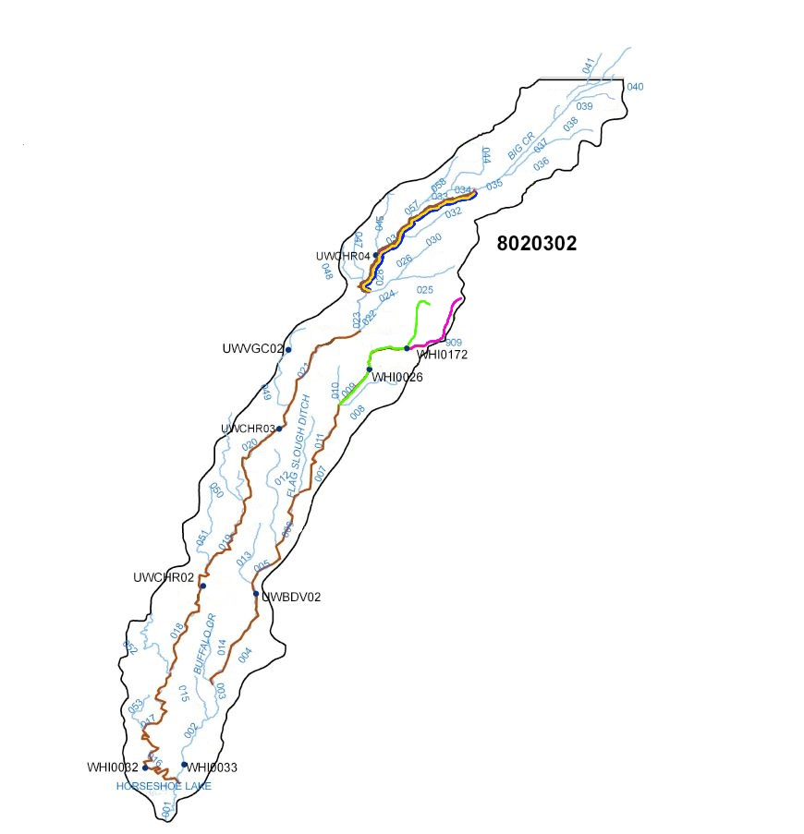
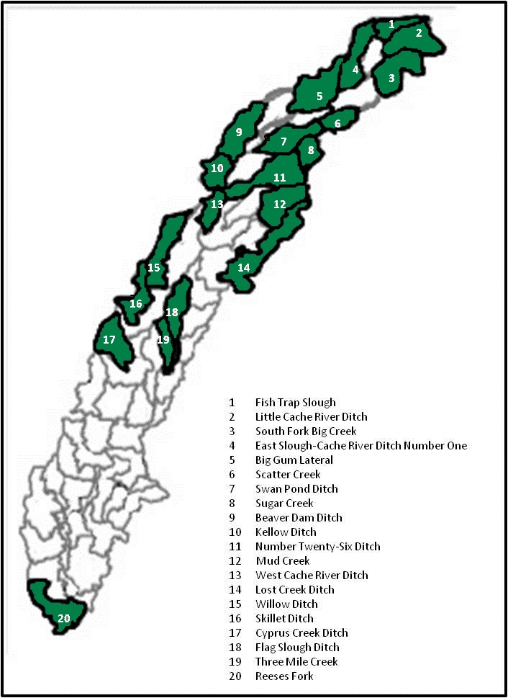
Lead (Pb)
Copper (Cu)
Chlorides (CL)
Turbidity (Tb)
Total Dissolved Solids (TDS)
USGS stations

Slide 12
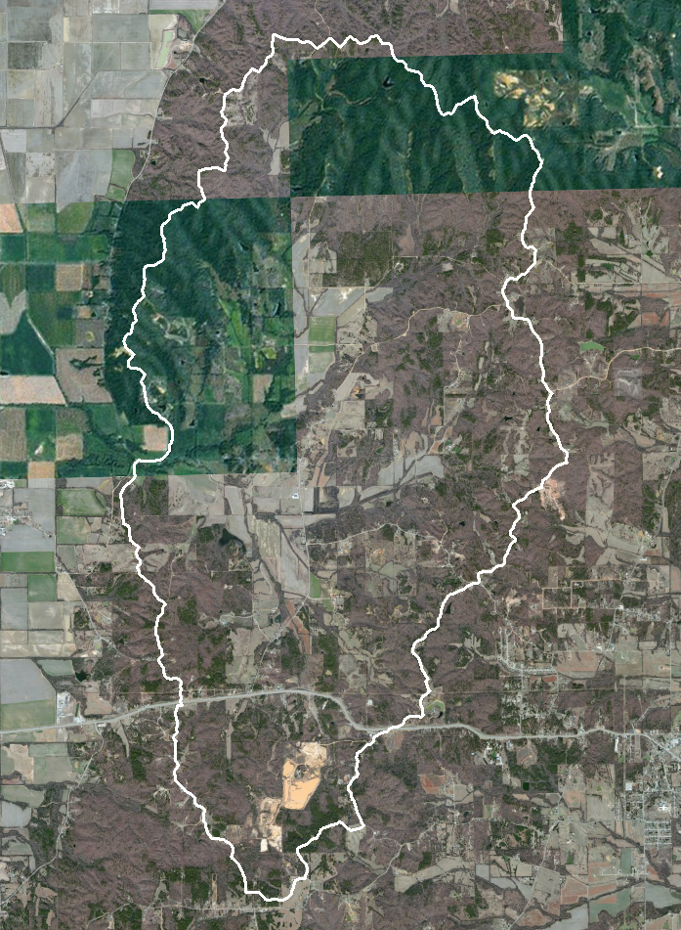
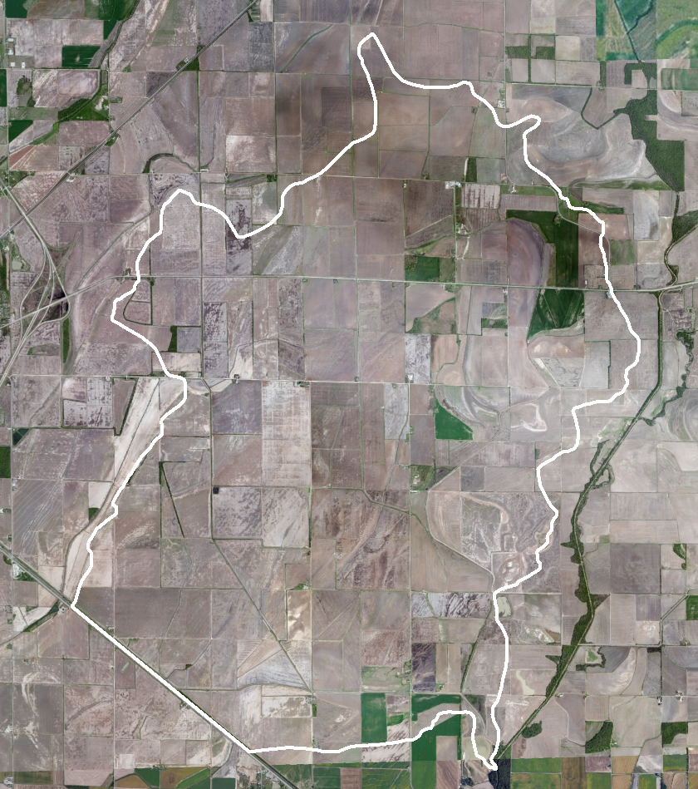
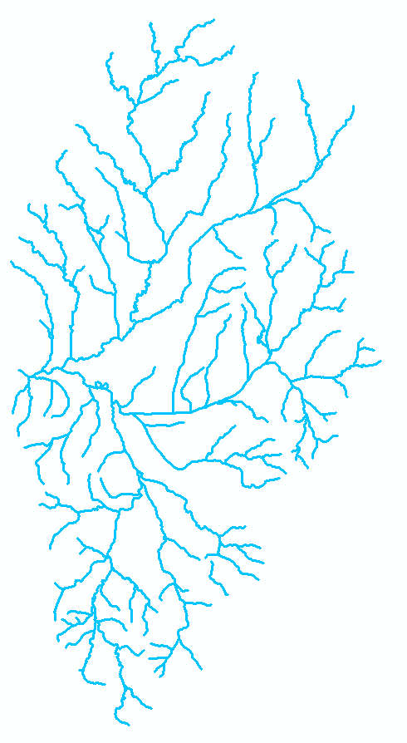
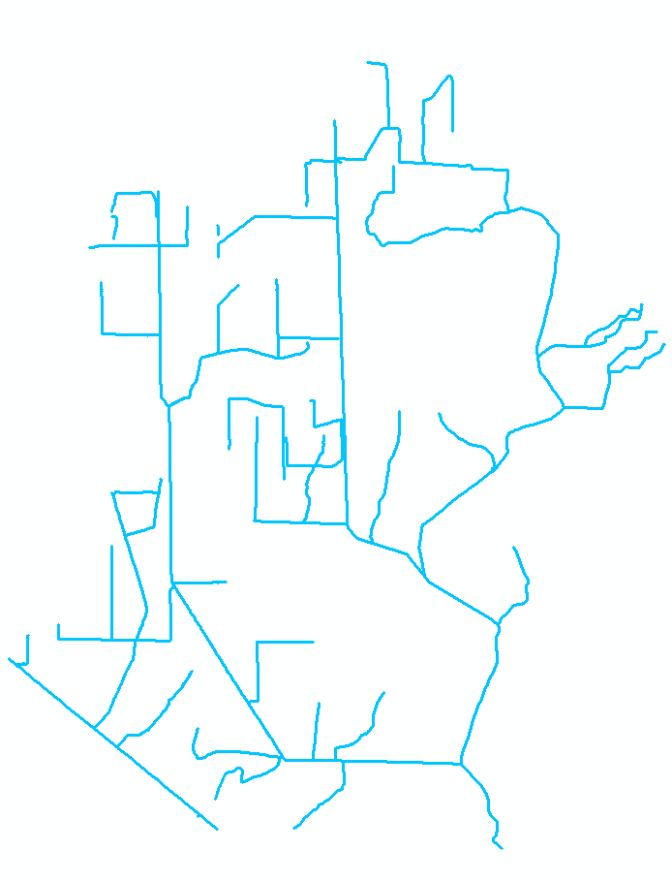
Least Altered (Sugar Creek)
Most Altered (Kellow Ditch)

Slide 13
p=0.12
p=0.01
p=0.18
p=0.03
p<0.0001
PO₄⁻³
NO₂⁻
NO₃⁻
p<0.0001
p<0.0001

Slide 14
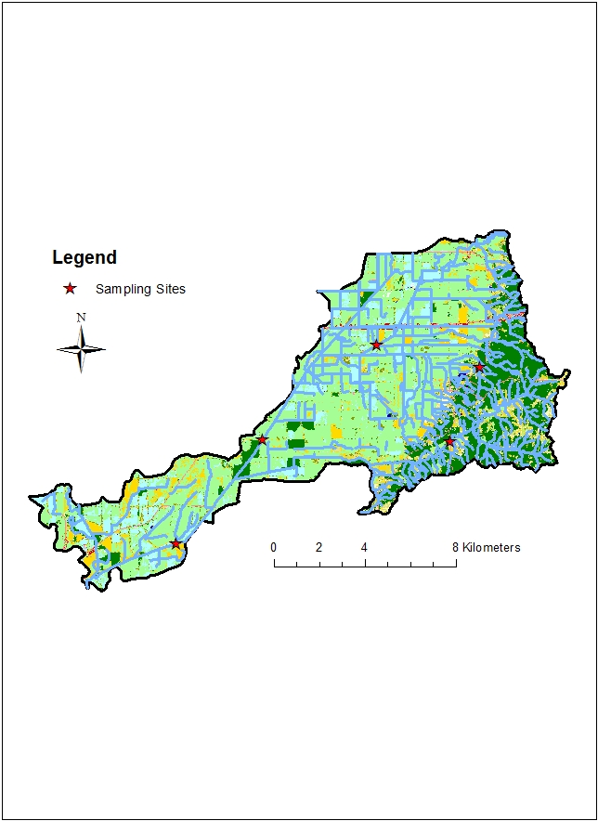
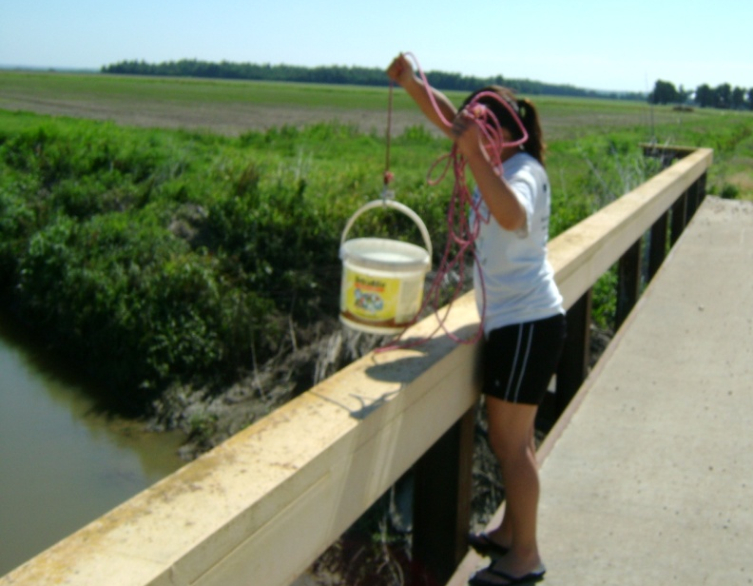
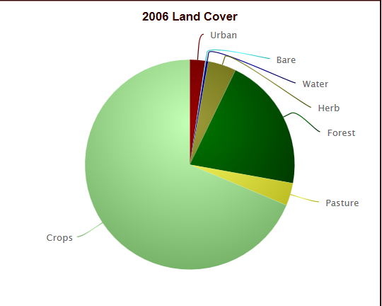
Twenty-Six Ditch
Sub-Watershed
Photo credit: Katie Kilmer
Natural vs. Channelized Sites
Physical, chemical, toxicological differences
Summer/Fall 2013

Slide 15
Physical Differences
p=0.004
p < 0.00001
Channelized Natural
Channelized Natural
168mg/L CaCO₃
205 mg/L CaCO₃
p<0.03
p<0.03
Channelized Natural
Channelized Natural

Slide 16
Chemical Differences
p<0.03
p<0.03
Natural
Channelized
*
*

Slide 17
Rainfall Jul 21-22
Rainfall May 22
Rainfall Jun 18

Slide 18
Current ELF Research
Effects of leaf litter on nutrient levels
Field sampling
Increased sample size of natural sites
Sampling throughout growing season
Lab experiments
Leaf leaching of nutrients into water

Slide 19
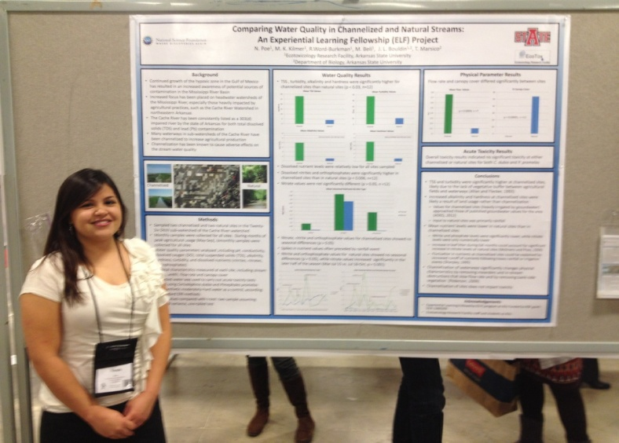
Masters Program: University of Oklahoma
Photo credit: Katie Kilmer
Comparing Water Quality in Channelized and Natural Streams
*Publication in preparation

