Slide 1



Student Learning Outcomes
Summer 2020 Workshop: Content Series #1
presented by: Dr. Summer DeProw
July 6, 2020
AState.edu
/ArkansasState
@ArkansasState

Slide 2



Workshop Procedures
Welcome and thank you for participating in our Summer Workshop Series!
You will be muted upon entry to the workshop, so please introduce yourself via the Chat feature by clicking “Chat.”
The window to the right will appear where you can add your introduction:
If you have questions during the session, please add them to the Chat box and at the conclusion of our time we will include them in the Q and A.
AState.edu
/ArkansasState
@ArkansasState

Slide 3
Workshop Learning Outcomes
Attendees will be able to:
Write a learning outcome for a program or a course using Bloom’s taxonomy
Identify Your Program’s Learning Outcomes (PLOs)
  Writing Your Own or Prescribed?
    Prescribed Standard/Competency/Outcome List(s)
    Conceptual alignment with University Learning Outcomes (ULOs)
Identify Program Outcomes (if any)
  “End of Program” Goals (Retention, Graduation, Post-grad Admission, etc.)
Understand how Course Learning Outcomes (CLOs) Fit with PLOs
  Using PLOs as CLOs in Capstone or other Culminating Courses
  Aligning CLOs to PLOs
Include Learning Outcomes on Syllabi
AState.edu
/ArkansasState
@ArkansasState

Slide 4
What is a Student Learning Outcome?
Learning outcomes are the knowledge, skills, attitudes, and habits of mind that students take with them from a learning experience. (Suskie, 2009). A statement that defines what a student should know or be able when he/she leaves a given course, degree program, etc.
Focus on the most important “take-aways” of the course/program/learning experience.
Think of this as “backwards design” or “reverse engineering”
Plan all assignments, assessment measures (AKA “assessments”), and facilitating technologies to help students reach the learning outcomes
Best practices suggest that 4-7 program-level student learning outcomes is sufficient for a program. HOW MANY FOR A COURSE?
AState.edu
/ArkansasState
@ArkansasState

Slide 5
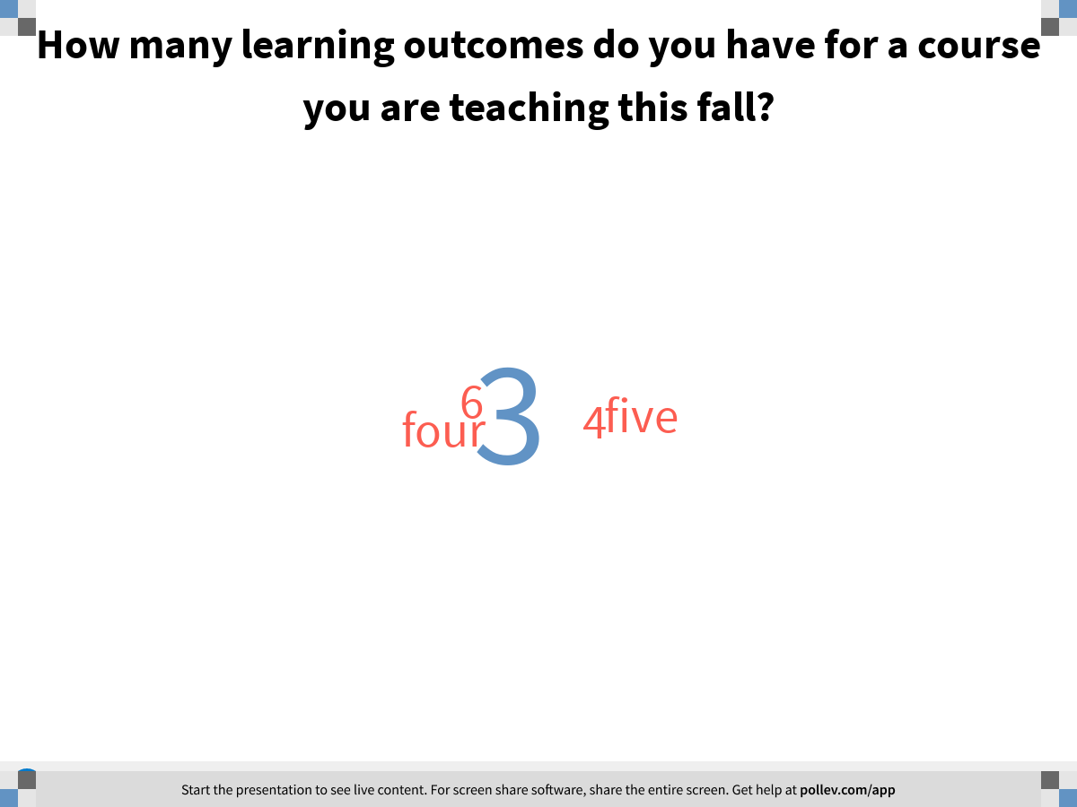
Notes:
How many learning outcomes do you have for a course you are teaching this fall?
https://www.polleverywhere.com/free_text_polls/02b4m6uLGdTBwOOXBvGdX

Slide 6
Nomenclature Mishaps…
Merriam-Webster Dictionary
Outcome: “Something that follows as a result or consequence”
Goal: “the end toward which effort is directed”
Objective: “something toward which effort is directed”
In the context of learning and programs/courses:
Goal: derived from a mission and characterized as what the program intends to accomplish
Objective: a refined more tactical statement of a goal and is many times used interchangeably with “outcome”
Quality Matters Evaluation: Objective is used many times for “outcome”
AState.edu
/ArkansasState
@ArkansasState

Slide 7
Student Learning
Outcomes should be S.M.A.R.T.
Specific-Outcome is focused on a specific category of student learning. If it is too broad it will be difficult to measure.
Measureable- Data can be collected to measure student learning.
Attainable- The outcome is attainable given the educational experience.
Results-Focused- The program outcome is aligned with Course-Level Student Learning Outcomes.
Tailored- Outcome is specifically tailored to the program.
AState.edu
/ArkansasState
@ArkansasState

Slide 8
Parts of a Student Learning Outcome
Introductory phrase
Action verb (driven by Blooms taxonomy)
Explicitly stated and observable skills and/or knowledge
Examples:
Students will understand the learning patterns of middle-school students.
Students will be able to explain the scientific method.
Graduates of the A-State CSPS program will be able to analyze intended and unintended effects of policies in higher education.
Let’s write one together.
AState.edu
/ArkansasState
@ArkansasState

Slide 9
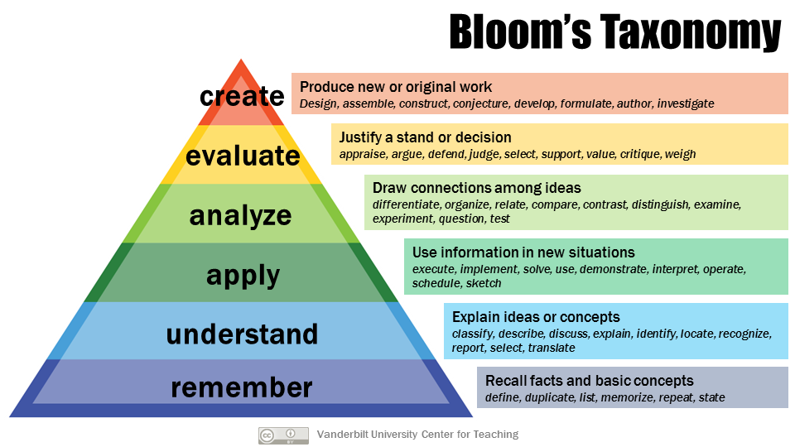
https://cft.vanderbilt.edu/guides-sub-pages/blooms-taxonomy/
AState.edu
/ArkansasState
@ArkansasState

Slide 10

Is learning linear?
AState.edu
/ArkansasState
@ArkansasState

Slide 11
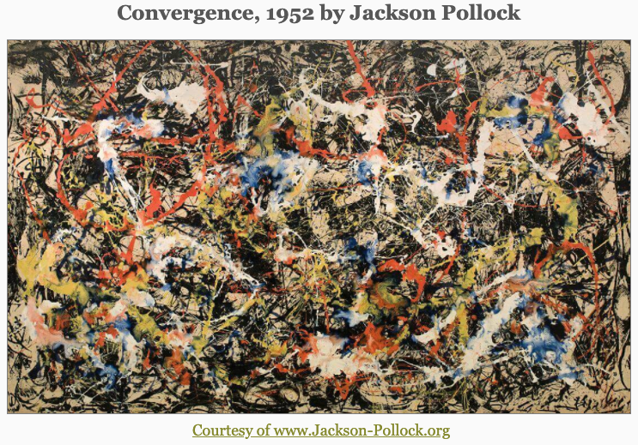
Bloom implied linear to give educators structure….
AState.edu
/ArkansasState
@ArkansasState

Slide 12
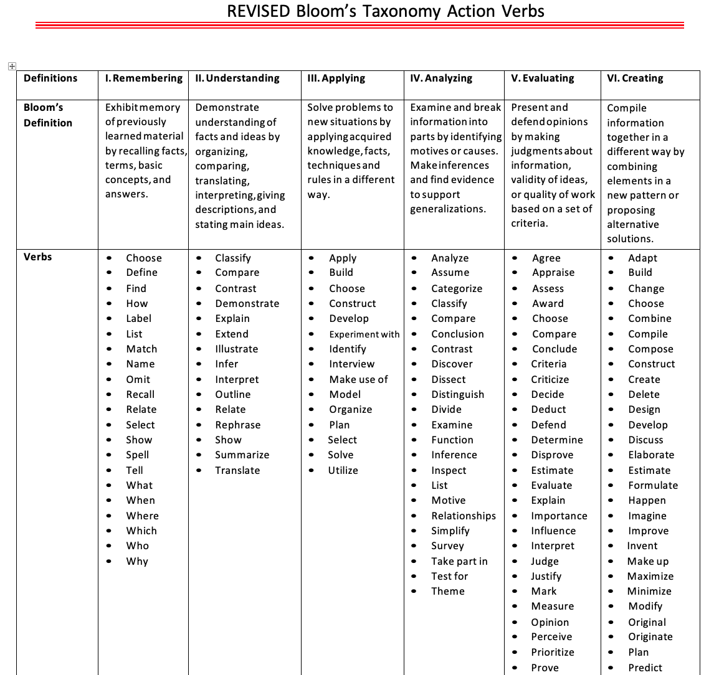
Select the Right Learning Verb…
AState.edu
/ArkansasState
@ArkansasState

Slide 13
Are more words better?
The Dr. Bert Greenwalt story…..
BS Agriculture Business graduates will be able to interpret financial statements of agricultural firms
AState.edu
/ArkansasState
@ArkansasState

Slide 14
Course Learning Outcomes
Program learning outcomes (PLOs) describe what a student should be able to do or know at the conclusion of an entire program. Course learning outcomes (CLOs) describe a knowledge or skill level expected in a single course.
When developing CLOs, it is important to consider how the course fits within the program and what knowledge and skills a learner is bringing with them and what skills and knowledge they should leave your course with to contribute to their future learning.
When constructing CLOs for a Capstone experience (i.e. culminating course, internship, final clinical experience, etc.), it is good practice to use the PLOs as the CLOs. Ultimately the Capstone should encompass all programmatic student learning goals.
July 8: Curriculum mapping!
AState.edu
/ArkansasState
@ArkansasState

Slide 15
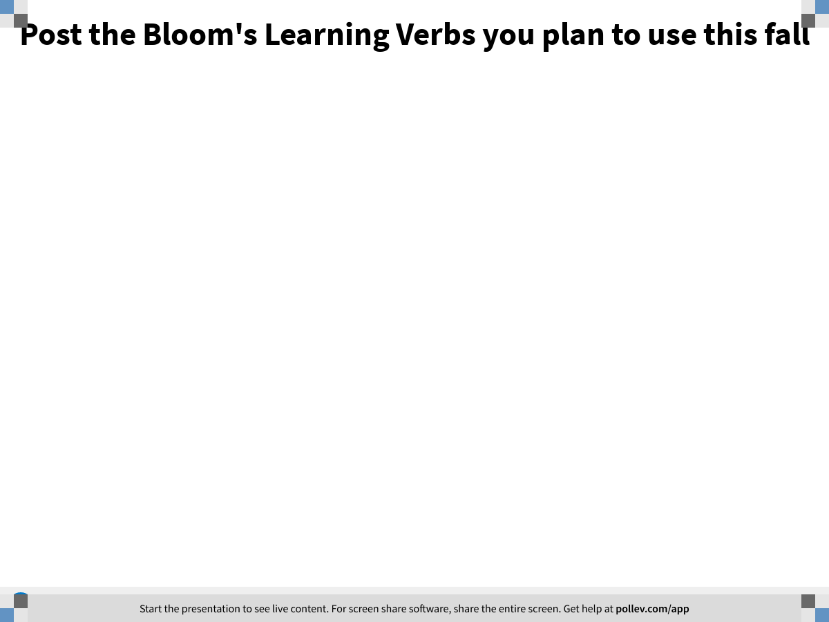
Notes:
Post the Bloom's Learning Verbs you plan to use this fall
https://www.polleverywhere.com/free_text_polls/B2mVP5fv0oE4p3Mgy3FKN

Slide 16
Use the Chat Feature in Zoom to:
WRITE A LEARNING OUTCOME
AState.edu
/ArkansasState
@ArkansasState

Slide 17
Conceptual Alignment
University
Program
Course
Mission
AState.edu
/ArkansasState
@ArkansasState

Slide 18
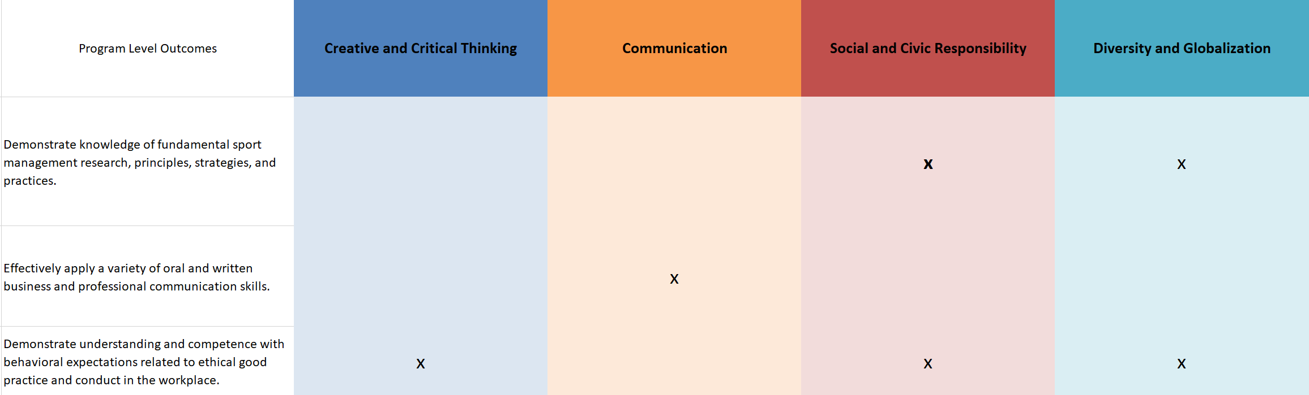
Program to University Learning Outcomes
Program Learning Outcomes (PLOs) can be prescribed if your program has an external accrediting body (i.e. ABET, ACEN, CAEP, AACSB, etc.) or can be written by Program Faculty.
When PLOs are established either internally or externally, they should be aligned to A-State’s University Learning Outcomes (ULOs) where the measure(s) serving the PLO also answer ULO(s).
AState.edu
/ArkansasState
@ArkansasState

Slide 19
Program or Administrative Outcomes
Administrative or End-Of-Program Outcomes are goals that a program or unit establishes outside of the measurement of student learning.
These can include:
  Graduation rates
  Internal or external presentations or journal publications of students
  Post-graduate plans including job acquisition or entrance to advanced degree programs
  Licensure exam pass rates
AState.edu
/ArkansasState
@ArkansasState

Slide 20
Conceptual Alignment
University
Program
Course
Mission
AState.edu
/ArkansasState
@ArkansasState

Slide 21
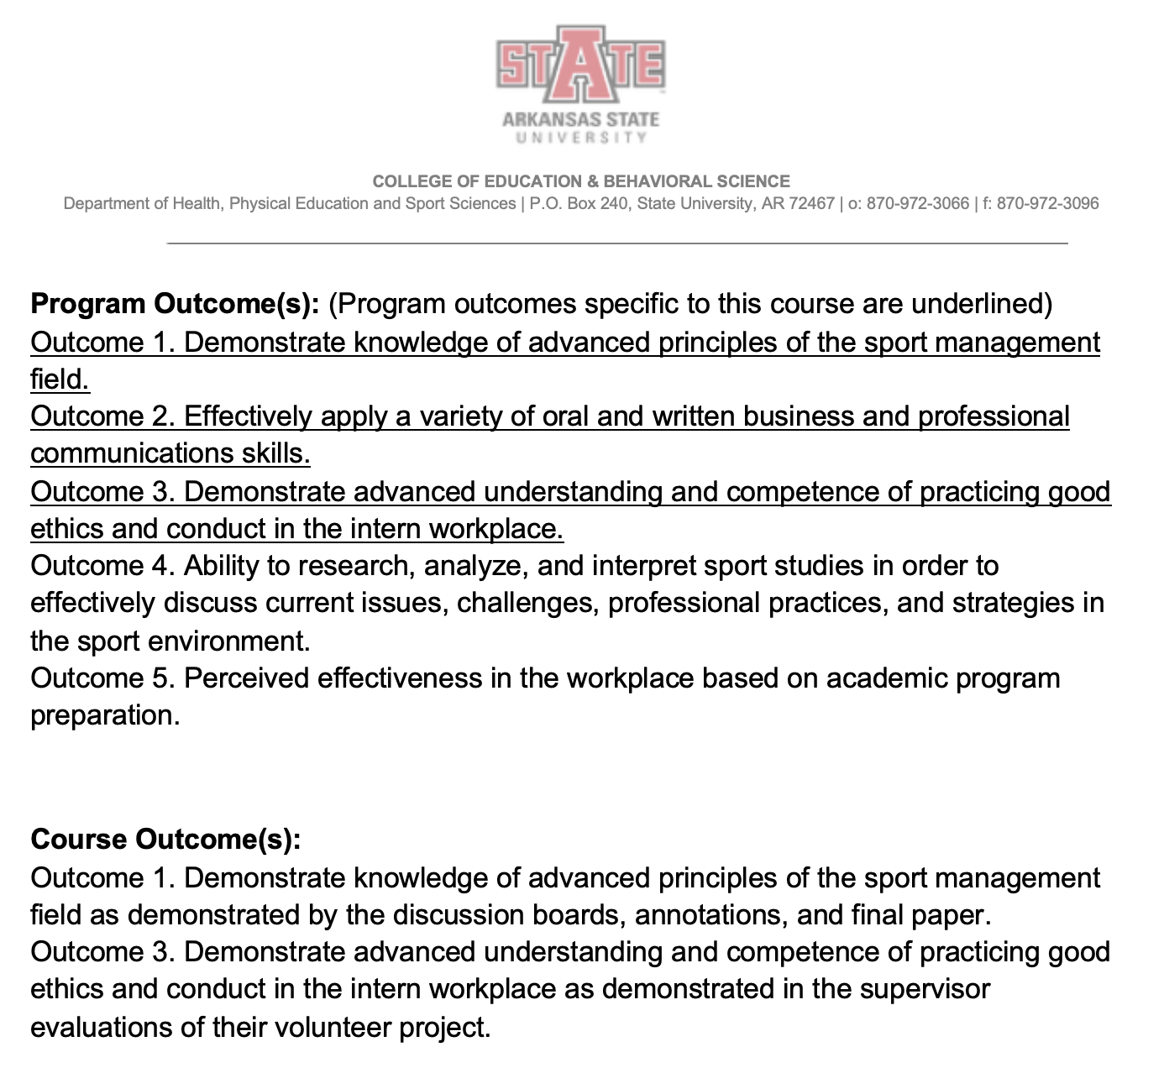
Learning Outcomes on Syllabi
AState.edu
/ArkansasState
@ArkansasState
Syllabi example courtesy of Dr. Claudia Benavides Ambs, Associate Professor

Slide 22

Session Q & A
AState.edu
/ArkansasState
@ArkansasState

Slide 23
Wrap-up
Practice writing a Learning Outcome:
  Is the outcome for a course or program?
  What is your introductory phrase?
  What Action Verb are you employing?
    Use Bloom’s Taxonomy to choose a verb that is at an appropriate level of learning for your intended outcome.
  What is the intended knowledge or skill that your students will display if meeting this outcome?
  How does your Course Learning Outcome align to a Program Learning Outcome(s)?
Can you identify an Administrative Outcome for the program your course contributes to?
  How can your course contribute to retention?
  Is your course a “barrier” (i.e. Capstone course, course in which a program assessment is collected, etc.) to graduation?
  Is there an opportunity for students to present their work in your course to an external body (i.e. journal article, public presentation, etc.)?
AState.edu
/ArkansasState
@ArkansasState

Slide 24
References
Hussain, W., & Addas, M. F. (2016, April). Digitally automated assessment of outcomes classified per Bloom’s Three Domains and based on frequency and types of assessments. Urbana, IL: University of Illinois and Indiana University, National Institute for Learning Outcomes Assessment (NILOA). Retrieved June 29, 2020, from https://www.learningoutcomesassessment.org/wp-content/uploads/2019/04/AiP_HussainAddasApril2016.pdf
Mcdaniel, R. (2020, March 25). Bloom's Taxonomy. Retrieved June 22, 2020, from https://cft.vanderbilt.edu/guides-sub-pages/blooms-taxonomy/
Suskie, L. (2009). Assessing student learning: A common sense guide (2nd ed.). Jossey-Bass.
AState.edu
/ArkansasState
@ArkansasState

