Slide 1



Welcome to A-State!
New Faculty Orientation
Cathy Naylor
Training & Development Coordinator
AState.edu
/ArkansasState
@ArkansasState

Slide 2
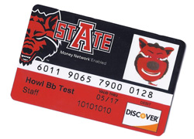

ID Card
Campus Card Center - Student Union – 2nd Floor
Uses:
Check Cashing @ Cashiers Window
Library for Checking out Books, DVD’s, etc.
Hotels – State Employee Discount may be available
Discounts at A-State Bookstore and Textbook Brokers
Local Restaurants and Stores
Reserved parking lots on Campus
Cafeteria Plan
15 Meals for $75
Payroll deduction

Slide 3
Parking Overview
Must purchase a Parking Permit if parking a vehicle on campus
Permits can be transferred as long as vehicle is registered
Permits are for August to August each year
Payroll Deduction
Parking Options:
$80 Faculty/Staff Parking
$60 Staff/Employee Parking permit
Reserved spaces available and assigned through Parking Services.
$500 for covered garage spaces
$300 for all other reserved spaces

Slide 4


Ordering Parking Permit
Log in to my.AState
Click on Parking eBiz icon
Employees must order new permit each school year
Permits are from August to August

Slide 5
Payroll
Pay Day
Semi-monthly
15th and last day of each month
If either falls on a weekend, payroll deposits will be issued on the Friday before
Retirement deduction begins with your first pay check
Vacation and Sick Leave
Vacation Leave: earn 15 hours per month (12 month faculty only)
Can carry over 240 hours each year
Sick Leave: earn 8 hours of sick leave per month
Can carry over 960 hours each year
You can view your balances by logging in to my.AState then click on your Banner Self Service icon.

Slide 6
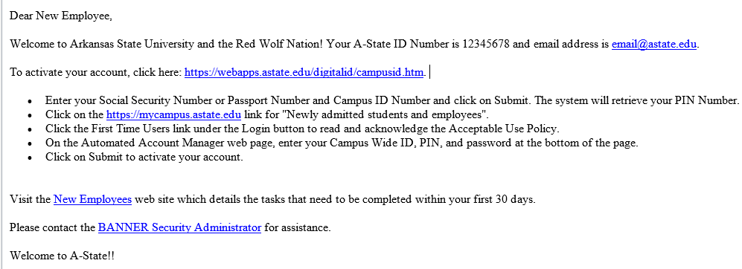
A-State Account Notification
New employees (full-time/part-time non-student) receive an email notification
Activate account and follow instructions on New Employee web page

Slide 7

Employee Training Requirements
Required for ALL employees
Blackboard Learn through my.Astate
COVID-19 Safety Training
Title IX (Sexual Discrimination)
Child Maltreatment
Privacy and Security
FERPA
Active Shooter Training

Slide 8
my.AState
Duo Login
Blackboard Learn
Employee Training Seminar
Parking eBiz
Banner Self Service
Pack Support
Concur - Travel

Slide 9
Banner Self Service
Viewing Paystub
Viewing Leave Balances
Submitting Leave Report
Viewing W-2 and 1095-C
Consent to receive electronically
Update personal information
Update address and phone number
Emergency Contacts

Slide 10
Employee Assistance Program
The St. Bernard’s Counseling Center EAP assists employees and their family members when dealing with problems that can occur in everyday life.
You can seek assistance in a simple and confidential manner from a trained professional.
Referrals to the EAP can be made by yourself, family members, supervisors or physicians, etc.
You will receive 6 free visits.

Slide 11
Additional Benefits
Free University Software Access/Download
For personal computer
Microsoft Office
Discounts on others
Education OR Wellness Leave (Physical Fitness Leave)
12 month faculty only
3 hours/week
Must be approved by supervisor
RedWolf Wellness Center
Free membership for faculty, staff, and spouses
More information from Spencer Bradley

Slide 12
Additional Benefits
Dean B. Ellis Library
Check out books, including popular selections
Rent movies, audio books, board games
Education Benefits
Available for Bachelor and Graduate degrees at each campus
Check the website for degrees that are eligible for the discount at any of the A-State locations statewide.
Bachelors = 75% Graduate = 50%
Professional Development Plan

Slide 13
Tobacco Free Campus
The Arkansas Clean Air on Campus Act of 2009
No tobacco is allowed anywhere on campus
Cigarettes
Cigars
Pipes
Smokeless tobacco
Vaping devices including e-cigarettes
Enforced by UPD
Fines from $100-$500

Slide 14
Drug-Free Workplace
The Drug-Free Workplace Act of 1988
Annual notice can be found:
On UPD webpage – Annual Security Report
Emailed out to campus community from Student Conduct each October

Slide 15


THANK YOU
&
WELCOME
TO
ARKANSAS STATE UNIVERSITY

Slide 16
Contact Information:
Human Resources: 870-972-3454
Benefits Questions: Mindy Williams
Parking Services: 870-972-2945
Training Questions:
Cathy Naylor: 870-680-8079

